Slide 1



PEILab Group Meeting
Leader: Zicong Hong
Team Member: Jian Lin, Haodong Wang, Qianli Liu, Kaibin Guo, Junjie Liu

Slide 2
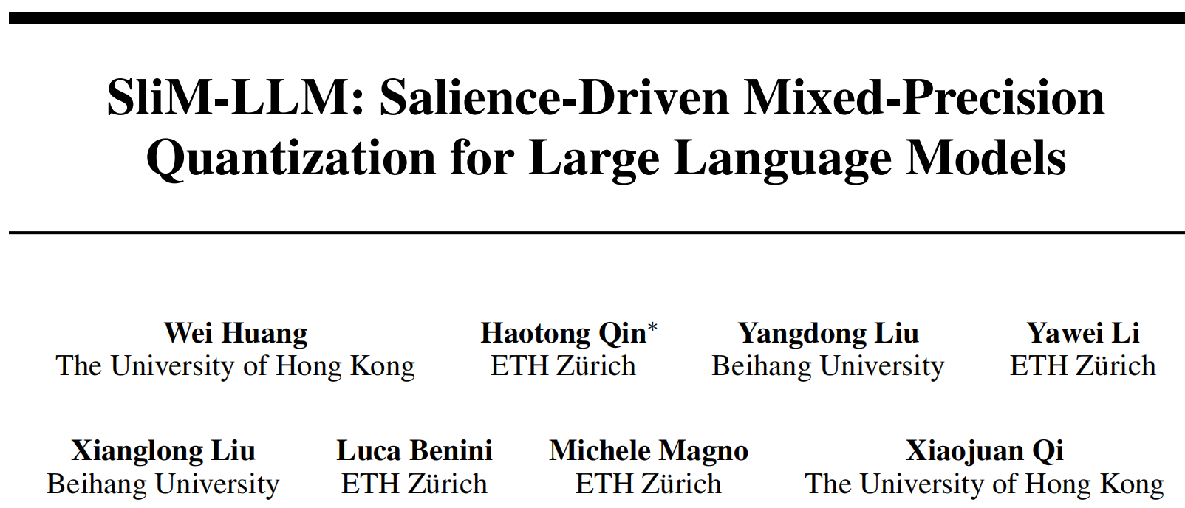
SliM-LLM
ICML’25

Slide 3
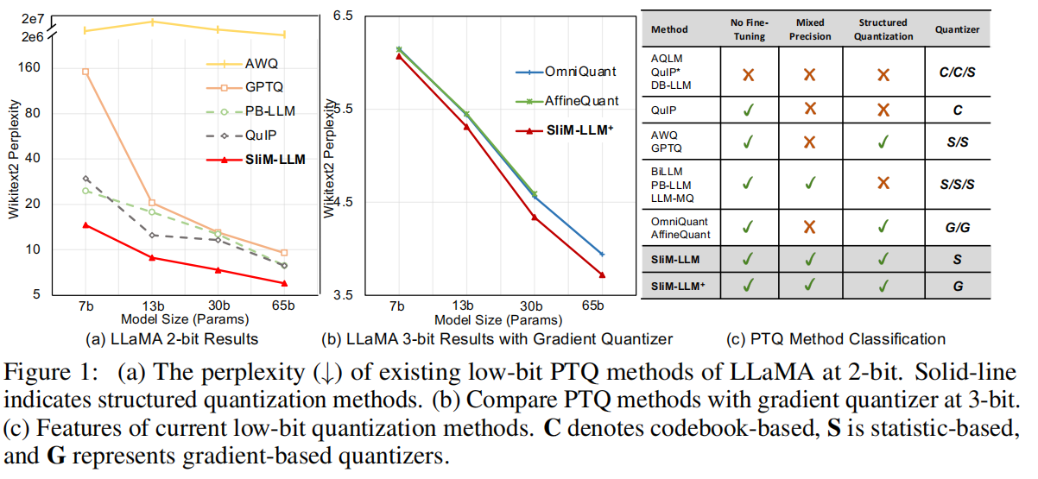
SliM-LLM

Slide 4
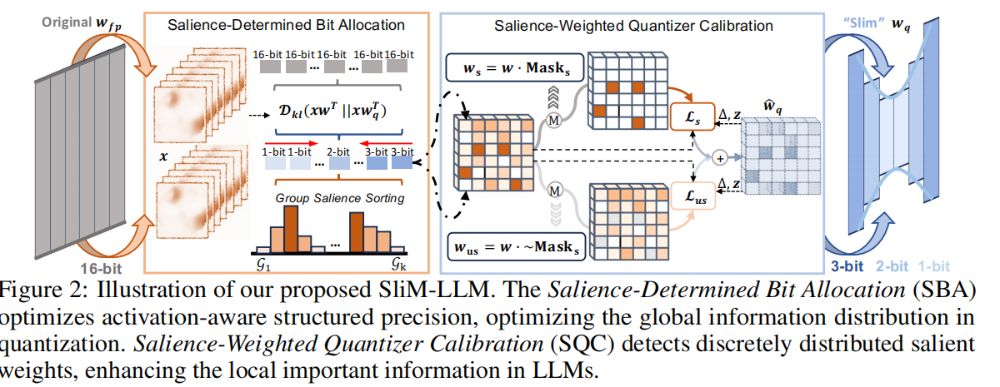
SliM-LLM

Slide 5
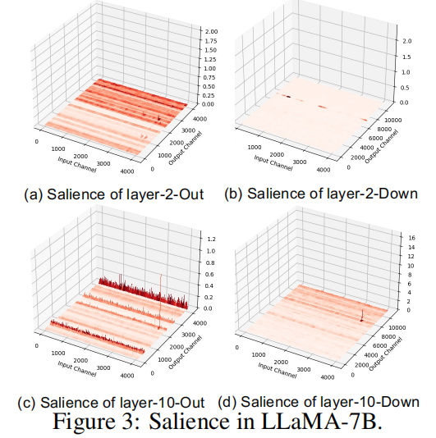
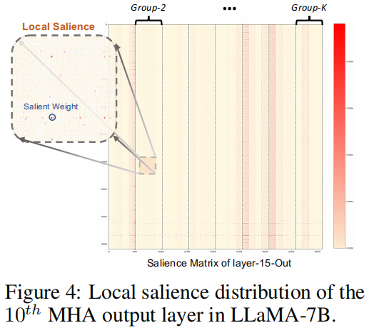
SliM-LLM

Slide 6
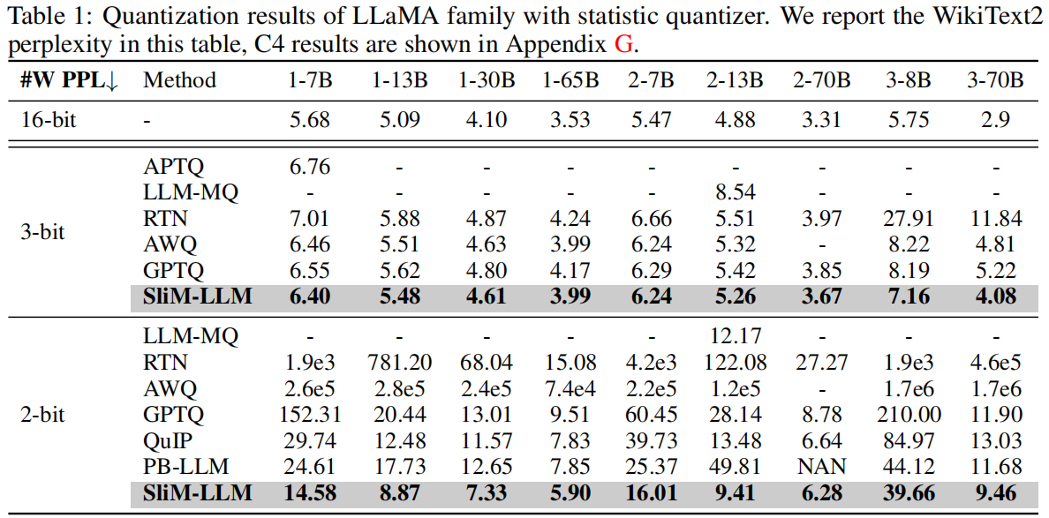
SliM-LLM

Slide 7
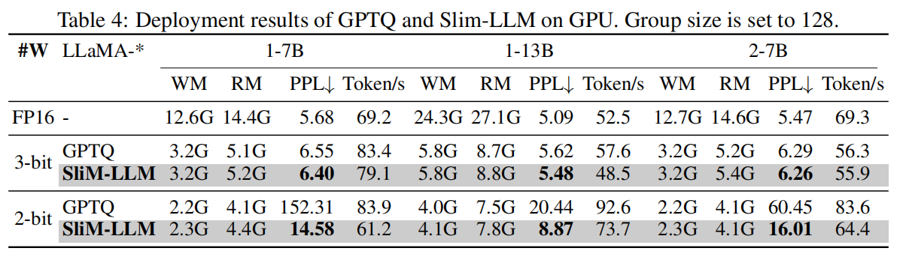
SliM-LLM

